Slide 1
Examination System
Aftab Ahmed <CS201010>
Afaque Ahmed Shah<CS201009>
Afaq Sabghatullah <CS201008>

Slide 2
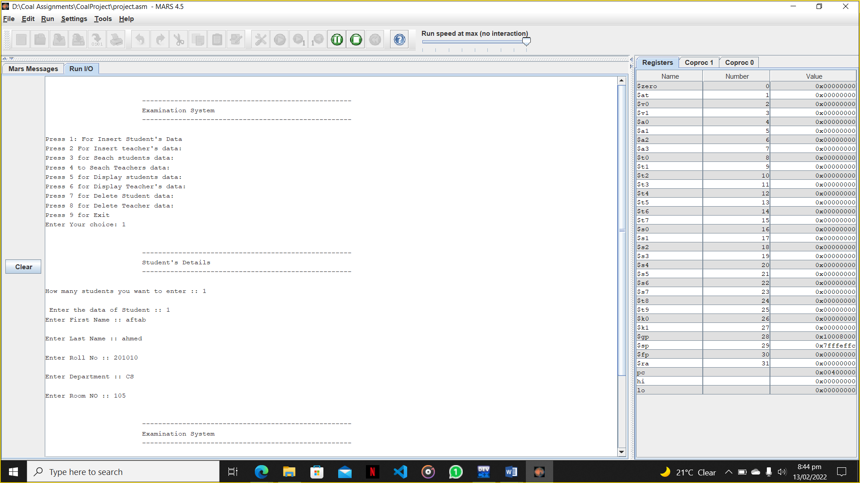
Introduction
Our project is based on concept of exams, where admin will collect data and perform several functions (insert, delete). Students and teachers will find out their examination / invigilation details

Slide 3
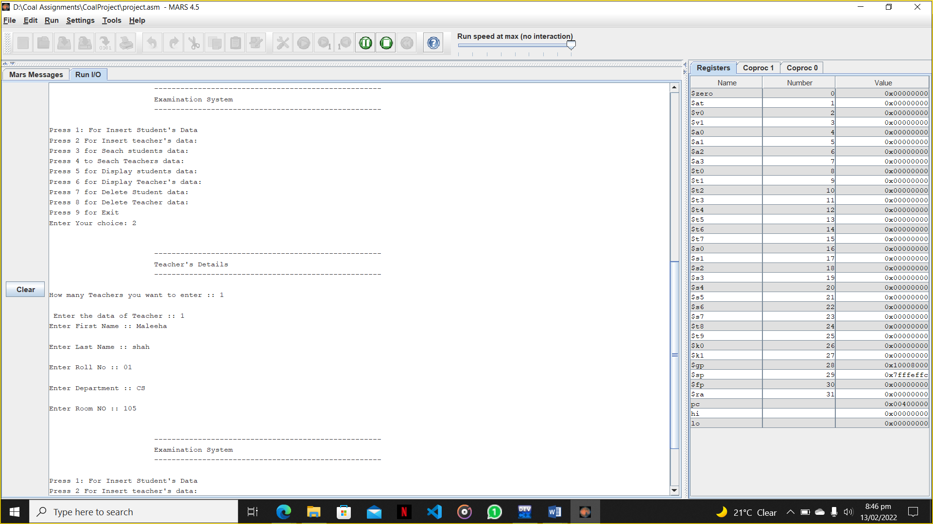
Insert Data
Admin can insert student’s data as well as teacher’s data:

Slide 4
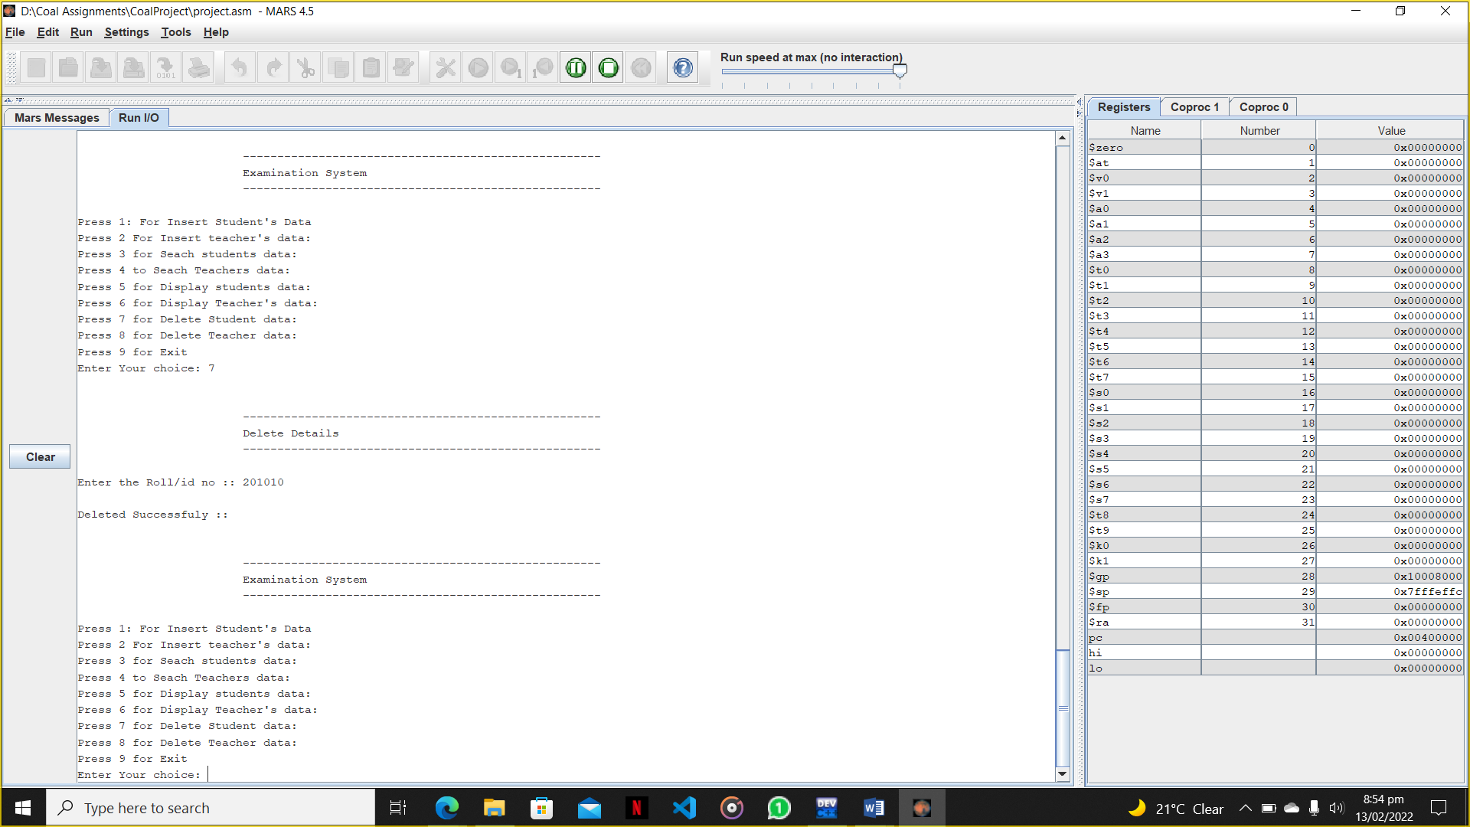
Delete Data
Admin can delete student’s data as well as teacher’s data:

Slide 5

Display Data
Admin can display student’s data as well as teacher’s data:

Slide 6
Details
Our project is based on the fact of a system that is used by admins department of number of institutions which play with the student information and data prior to exam time and this makes it easier and appealing for user be it a teacher or student that he can see and find his/ her room number , exam time and place very prior to the exam day and easily reach out to the exam spot before time
Our project used file handling , branching , procedures and stack

